Slide 1
TEACHING WITH i-Tree
(YOUR NAME)
Download the i-Tree app on your phone.

Slide 2
What is i-Tree?
Free, online tool that calculates the dollar value of the benefits provided by a tree or set of trees
i-Tree Design software: free, state-of-the-art online tool developed by the U.S. Forest Service and partners
PLT module contains 3 hands-on activities that help students discover and analyze the many ecosystem services that trees provide
Students collect data and input into i-Tree

Slide 3
Application of STEM Skills Addresses concepts in biology, ecology, economics, language arts, and technology. In addition to developing content knowledge, students develop critical thinking skills and discover the importance of scientific investigation.
Identify trees
Measure and assess the health of trees
Assess the value of trees and their role in mitigating greenhouse gases, improving air quality, intercepting stormwater, lowering a building’s energy use, etc.
Calculate the dollar value of the benefits provided by a tree or a set of trees
Analyze and interpret their findings
Use i-Tree tools to develop plans to improve the environmental functions that trees provide on their school grounds or in their community.

Slide 4
Teaching With i-Tree Module
Student Lessons
Supporting Resources
Activity 1: Tree Benefits and Identification
Activity 2: Tree Value
Activity 3: Land Manager Role Play
Video tutorials
Lesson plans
Student worksheet, and more!

Slide 5
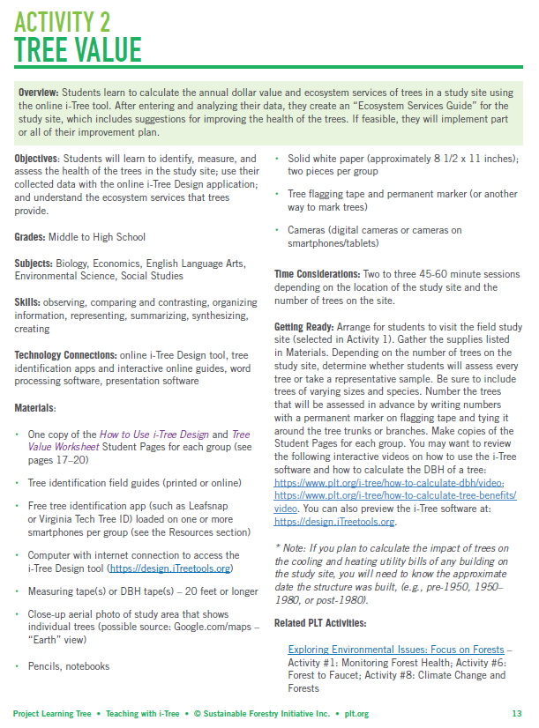
Activity Features
Overview
Grades
Skills
Technology
Connections
Materials
Getting Ready
Related PLT Activities
Assessment Opportunities
Background Information
Doing the Activity
Resources
Student Pages

Slide 6
Activity 1: Tree Benefits and Identification
Overview
Objectives
Students will discover the many products we obtain from trees, how we all depend on trees in our daily lives, and the value of trees to communities and our environment.
Learn the features of trees that are used in identification, and practice identifying trees using tree identification guides and free mobile apps.
Introduced to the i-Tree software and learn how it can be used to quantify the benefits of trees
Students will discover their dependence on trees
Students will learn how to identify trees
Students will learn methods for quantifying the benefits that trees provide

Slide 7
Tree Products = >5,000!
Products
Examples?
Wood products
Cellulose products
Sap products
Paper/pulp products
Foods
Bark products
Wood-derived chemicals

Slide 8
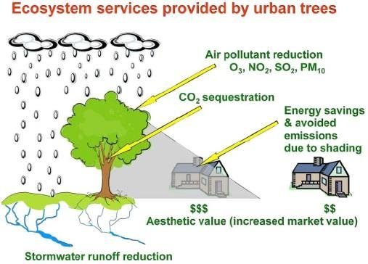
What other benefits from trees?

Slide 9
Ecosystem Services
Definition
Examples
Clean water
Oxygen
Nutrient cycling
Carbon storage (even after a tree is made into lumber or other products)
Temperature regulation and rainfall
Wildlife habitat
Services that humans derive from environmental functions such as photosynthesis, biodiversity, oxygen production, watershed protection, carbon sequestration

Slide 10
Can we give a value to these services?
https://design.iTreetools.org

Slide 11
Part B: Tree Identification
Arrangement
Simple or compound
Leaf characteristics
Twigs
Fruit, flower, seeds
Bark
Tree shape
Tree ID Resources
Dichotomous key
Field guides
Forest Trees of SC
Golden Guide – Trees of N. America
Apps
PlantSnap
Virginia Tech
iNaturalist

Slide 12
Part C: Tree ID Outdoors
Work in pairs with field guides and tree ID app
Identify 6 trees
Measure diameter of each tree

Slide 13
Activity 2: Tree Value
Overview
Objectives
Students will learn to calculate the dollar value and ecosystem services of trees in the study site using the online i-Tree tool.
Enter and analyze date
Create and “Ecosystem Services Guide” for the study site
If feasible, implement part or all of their improvement plan
Students will learn to identify, measure, and assess the health of the trees in the study site
Students will use their collected data with the online i-Tree Design application
Students will understand the ecosystem services that trees provide

Slide 14
Calculate Value Using App
Need:
Aerial photo of site showing North or compass
Smart phone with i-Tree app
Tree Value Worksheet
Diameter tape
Record results on Tree Value Worksheet for your group’s tree

Slide 15
Create a graph of results
“Tree Diameter” on x-axis
“Dollar Value” on y-axis
What was the diameter of the tree with the greatest value? Least value?
What trends do you notice?

Slide 16
Tree Value: Discussion Questions
Were you surprised to learn dollar value of your tree?
What ecosystem services does your tree provide?
Why are these ecosystem services important?
How does the value of your tree compare to those of other trees?
Why is it important to care for trees?
Now that we know the value these trees provide, how might that influence the future management of the study area?

Slide 17
Doing the Activity
Use i-Tree Design to calculate dollar value of the ecosystem services that trees provide at https://design.itreetools.org/
Video tutorial at https://www.plt.org/i-tree/how-to-calculate-tree-benefits/video

Slide 18
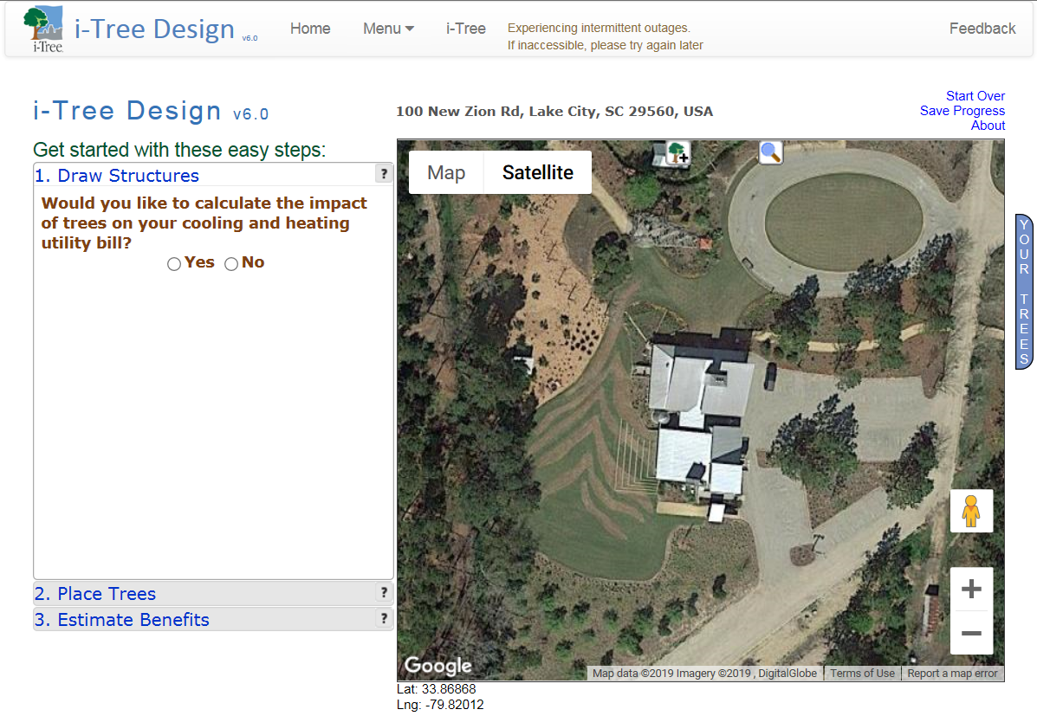
Find flagged tree & photograph
Identify tree
Measure DBH
Determine tree condition
Determine exposure to sun
Calculate $ value/year using i-Tree app
Read about ecosystem services

Slide 19
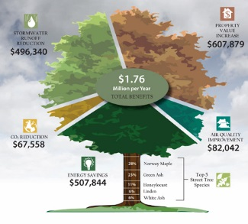
Ecosystem Services Guide
Overview of the ecosystem services and other benefits trees provide
Map of route for walking the study area that highlights interesting trees and various ecosystem
Descriptions of tree species and other pertinent features of the trees and the study area
Suggestions for caring for and improving the health of the trees in the study area

Slide 20
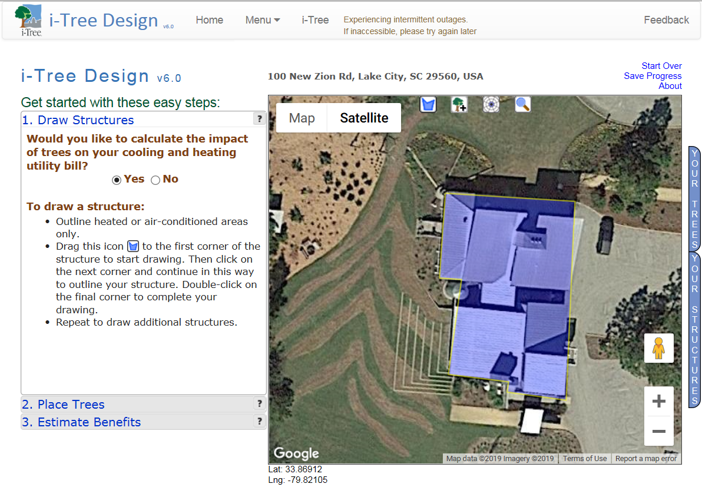
Draw Structures

Slide 21
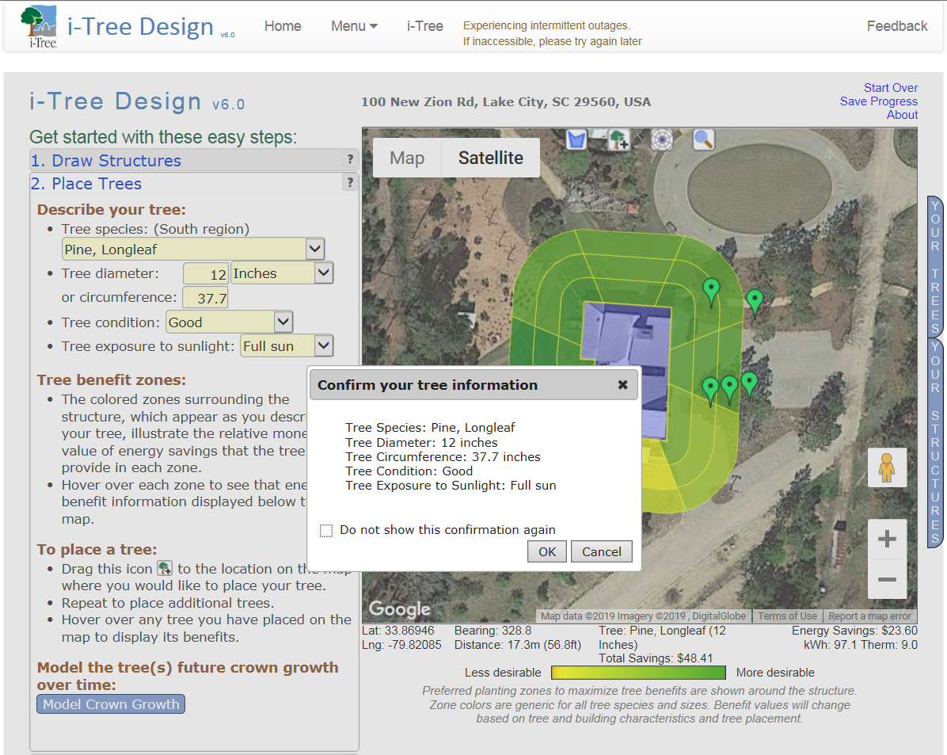
Place Trees

Slide 22
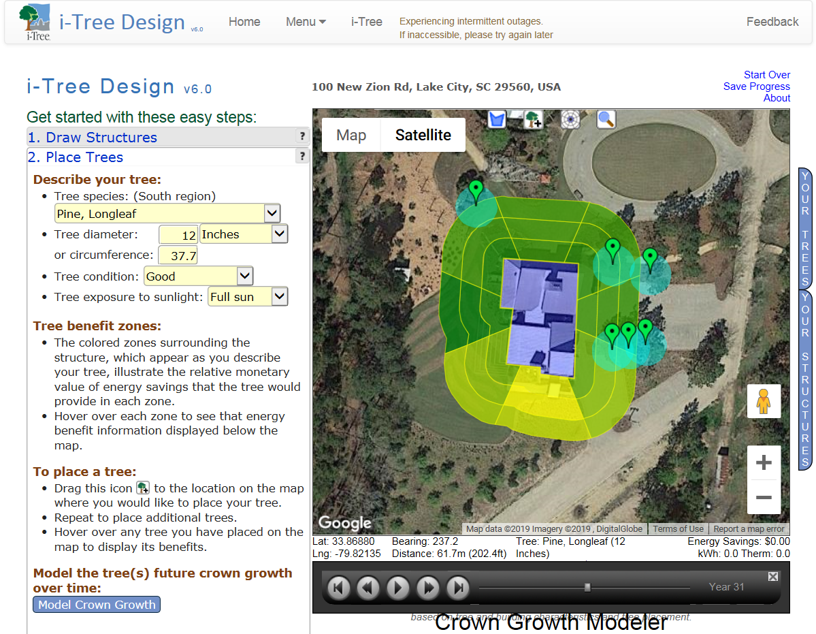
Model Crown Growth

Slide 23
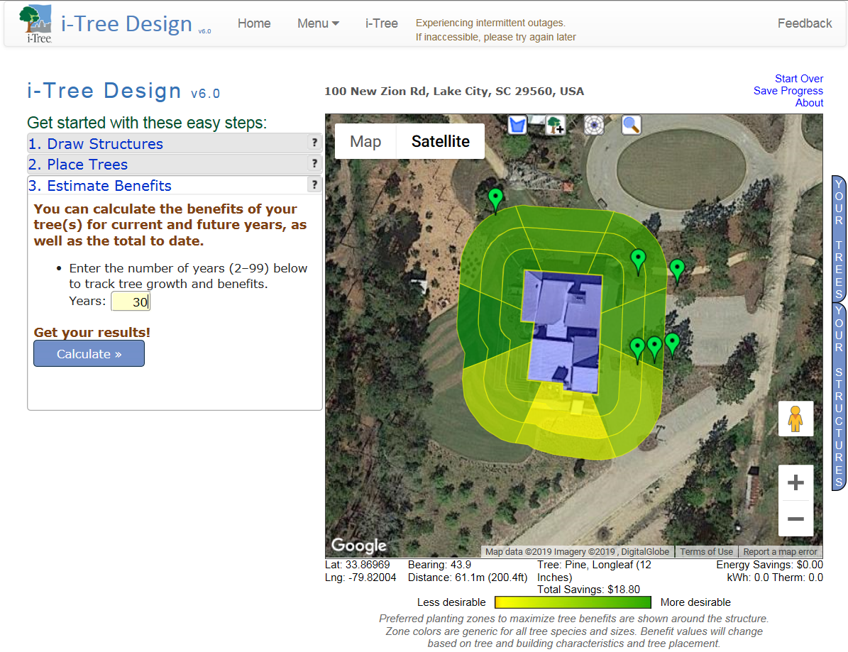
Estimate Benefits

Slide 24
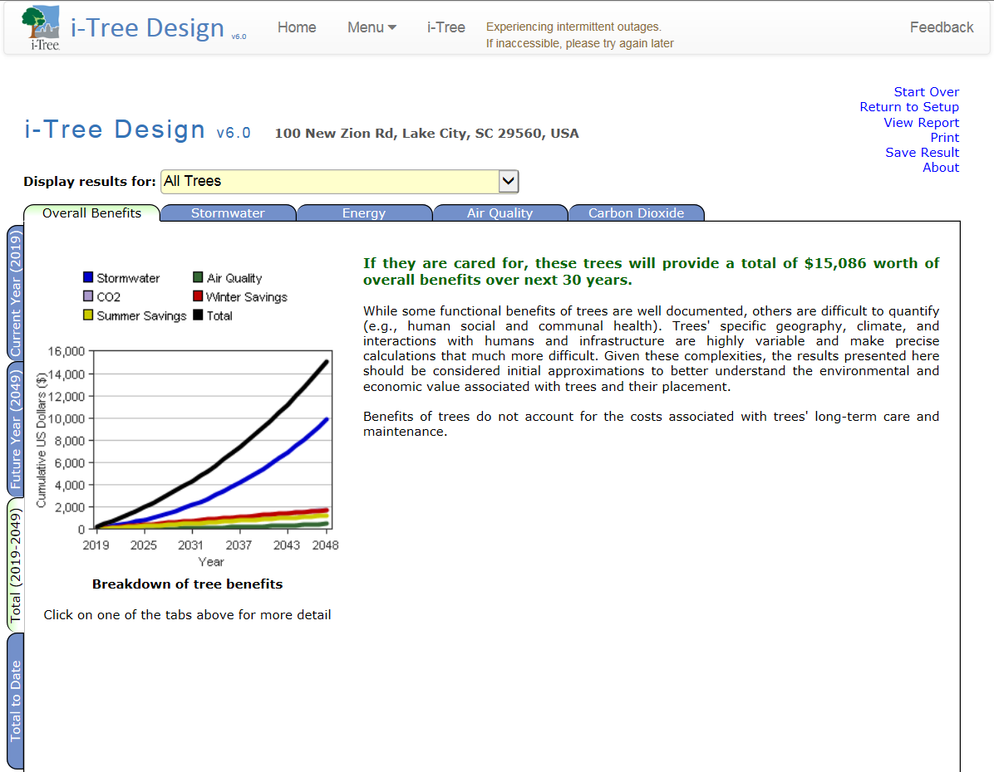
Review Benefits

Slide 25
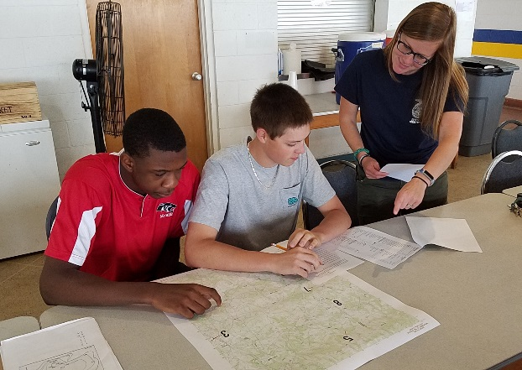
Activity 3: Land Manager Role Play
Overview
Objectives
Now that students know how the i-Tree tool, they will apply what they’ve learned as they role-play being land managers
Students learn how the i-Tree tool can be used to help solve landscape design problems
Students will gain skills in presenting and communicating scientific information

Slide 26
Careers in Land Management
Landscape Architect/Designer
Urban Planner
Forester
Forest Fire Manager
Urban Forester
Arborist
Silviculturalist

Slide 27
Role-Play
Students role-play being land managers who are tasked with developing a plan to increase the number of trees on the school grounds (or other designated area).
Opportunity to apply critical-thinking and problem-solving skills in a real-world situation

Slide 28
Use i-Tree Tools
i-Tree Design
i-Tree Species
https://species.itreetools.org

Slide 29
Goal of the Plan
Increase shade to cool landscape
Provide shelter and food for wildlife to increase biodiversity
Intercept storm water runoff to slow erosion and protect a nearby stream
Enhance the beauty of the area and provide a relaxing place to study
Absorb air pollutants (O3, NO2, SO2)
Reduce carbon dioxide
Combination of 2 or more of above

Slide 30
The Plan
How many additional trees could be planted at the site?
Which tree species should be planted to help achieve goal(s)?
Develop plan
Present plan
Use Google Maps “satellite” view to locate site
Use the i-Tree Species tool to select the best trees to achieve the goal(s).

Slide 31
Additional Considerations
Right Tree, Right Place
Native species vs non-native species
Invasive species
Invasive Species Program Clemson University
Soil Surveys
Web Soil Survey

Slide 32
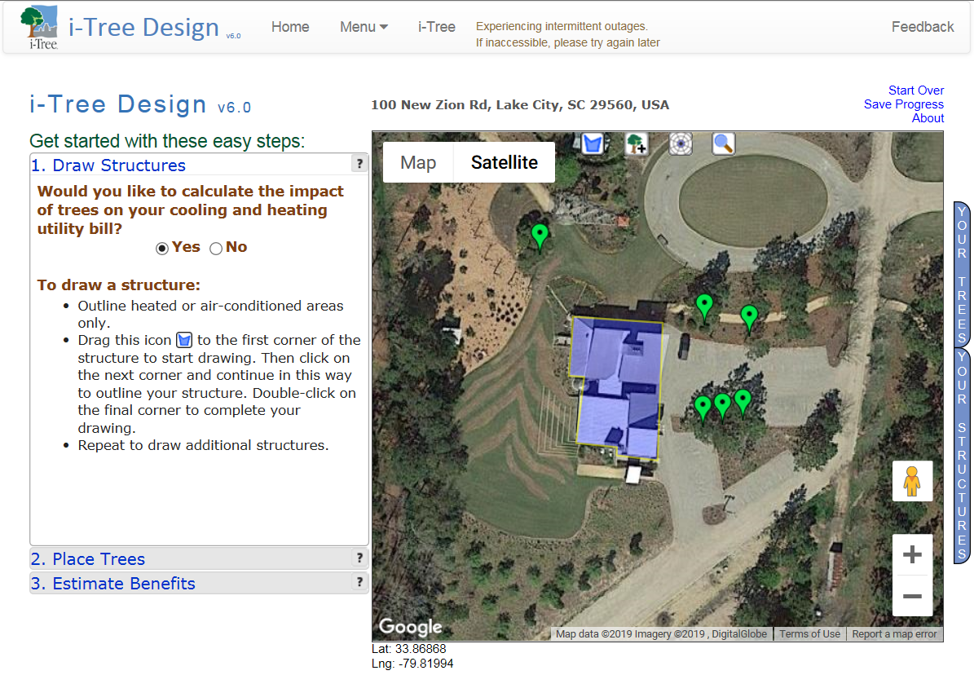
How could you improve the Fire Tower Center at Moore Farm & Botanical Garden?

Slide 33
Questions?
(YOUR CONTACT INFO)

