Slide 1


SC Project Learning Tree 2020 Facilitator Refresher
Notes:
Living in time of disruption, community critically important

Slide 2

Our Vision:
A world that values and benefits from sustainably managed forests.
Education Pillar Goal:
To advance environmental literacy, stewardship, and career pathways using trees and forests as windows on the world.
Notes:
Vision and Education Pillar Goal
Esther for introduction to the e-summit

Slide 3
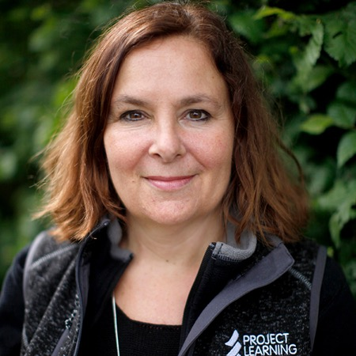
PLT STAFF
Kathy Abusow
President and CEO
Sustainable Forestry Initiative
Notes:
Acknowledge Esther’s leadership, work is to implement PLT’s new Business Plan, deep and broad understanding of PLT network, partners, products, and opportunities
New staff (Sheden, Rocco, Tara)
Team effort to plan and organize e-summit

Slide 4



RECENT AWARDS & RECOGNITION
In 2020, 18 PLT GreenSchools recognized as
Over 5,000 Registered
PLT GreenSchools in US
166 newly registered in 2020
Notes:
Carbon & Climate won 2020 Teachers’ Choice Award
18 PLT GreenSchools recognized as part of the Department of Education’s Green Ribbon Schools Awards Program
Now over 4,000 PLT Greenschools, 166 added so far this year

Slide 5

RESPONDING TO COVID-19
EDUCATORS
NEARLY 3,700
signed up for online courses or purchased e-books
HOME-SCHOOLING FAMILIES
12,000+
activities downloaded
NEARLY 89,000 activities viewed online
Notes:
50% off sale of online PD
support need for educators and coordinators to expand virtual offerings
alleviate financial constraints for both coordinators and educators
nearly 3,700 educators gained access to online pd and purchased e-books
Free family activities
help educators get kids outside as part of online learning
support parent who were homeschooling
over 12,000 activities downloaded
nearly 89,000 activities viewed online

Slide 6
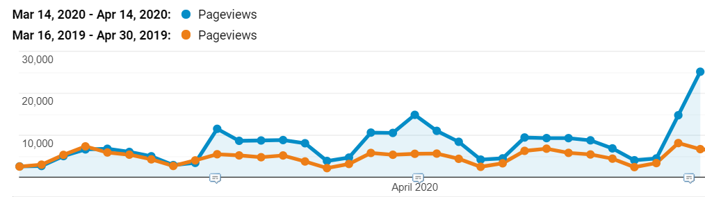
PLT’S EARTH DAY CAMPAIGN - Pageviews
THE BRANCH DRIVES RECORD TRAFFIC TO PLT.ORG
MARCH 23RD
APRIL 1ST
APRIL 14TH
Notes:
Reaching people new to PLT
Raising brand awareness
Notice the peaks related to specific Branch and email announcements
Shows effectiveness of messaging and communications for educator audience

Slide 7
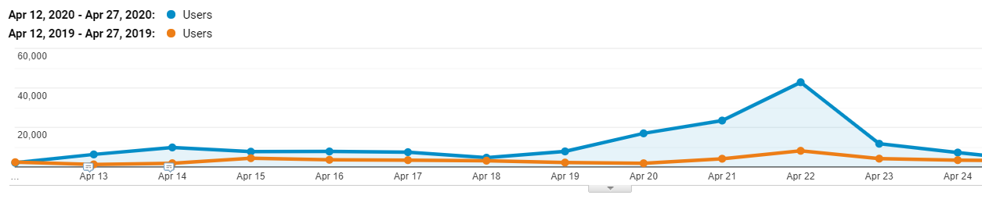
PLT’S EARTH DAY CAMPAIGN - Sales
Hitting new heights!
APRIL 14TH
EARTH DAY 2020
43,000 visitors
72,000 pageviews
10,000 visitors
25,000 pageviews
Notes:
• Hit the stratosphere on Earth Day
• 43,000 visitors
• 72,000 website page views

Slide 8

RESPONDING TO EMERGING NEEDS
EDUCATORS & FAMILIES
Nature Activities for Families
update and reprinting
New Thematic Bundles
available online only
Notes:
Nature Activities for Families
out of print due to Covid
USFS funding to revise and reproduce
New Thematic Bundles
3 activities from the current PreK-8 guide
organized around a particular topic or theme, for example “Trees As Habitats”,
for sale on Shop as downloadable PDFs.
Intent is to expand access to PLT’s amazing activities AND drive demand for educators to attend amazing PD offered by states

Slide 9

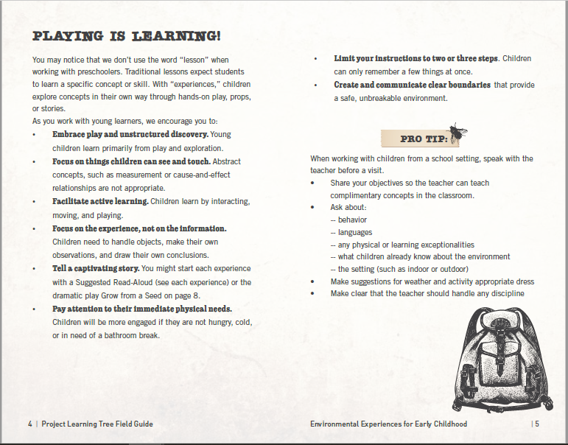

RESPONDING TO EMERGING NEEDS
DEVELOPING AND REPURPOSING PLT CONTENT WITH PARTNERS
Quick Guide for Forestry Professionals
  In Partnership with Florida PLT & Rayonier
  Weyerhaeuser
Early Childhood Pocket Guide
  In partnership with IP
Cyberchase: Green It Up!
  FL, IN, MT, NM, NY, OH, RI, TN, TX & VA
Notes:
RAYONIER & WY
Need for activities to be more accessible for forestry & NRP
Simplifying small collection of activities and producing either in print (RAY) or making available online (WY)
In RAY case, FL PLT will be shared in workshops specifically for RAY’s forestry professionals, K-8 plus Quick Guide
Will make resources available to everyone after pilot testing
Thank you FL PLT, Ray & WY
Pocket guides as potential new product line
Designed to fit into pocket
Intended for families & NRP/employee engagement programs
Activities that are condensed and simplified for ease of use by non-educators
Guidance on working with specific audience or content
First one is focused early childhood
IP funded
CYBERCHASE GREEN IT UP!
Cyberchase Green It Up is children’s program on public TV
Developed by WNET, America’s flagship PBS station, headquartered in New York, NY
approached us, courtesy of Bora Simmons
Jackie serving as a curriculum consultant to help develop Cyberchase Green It Up educational content, including activity cards, home connections, a poster, and more.
These educational materials will be available nationwide from the Green It Up! website,
Paired with WNET funding to 10 targeted PBS stations across the USA: FL, IN, MT, NM, NY, OH, RI, TN, TX & VA
Connect to PLT programs in those states; If not heard yet from Jackie, you will soon

Slide 10
PLT Business Plan Adopted 2019
Education Pillar GOAL
To advance environmental literacy, stewardship, and career pathways using trees and forests as windows on the world.
INITIATIVE I: RELEVANCE
I a. Product Line and
Forest Learning Framework
I b. Brand Refresh
I c. Standards Alignment
INITIATIVE II: REACH
II a. Network Capacity Building
  Grants to the Network
  Facilitator Development and Support
II b. Digital Optimization
REVENUE from government and foundation grants, contributions and sponsorship, and product and program sales
Notes:
Adopted Business Plan Strategy to guide growth in fall
State Coordinators at heart of PLT Community
We listened to you closely when developing Business Plan
A principal section of plan is dedicated to Network Capacity Building
Grants, which Kathy highlighted for 2020 grant giving
Facilitator Development and Support

Slide 11
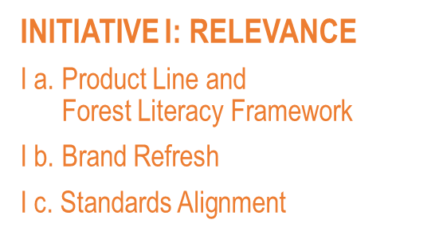
PRODUCT LINE
NEW AND REVISED PRODUCTS
Green Jobs
  “Find Your Green Job” Online Quiz
  New Online Course
  Marketing Campaign
K-8 Environmental Education Activity Guide
  Revised Guide
  New Online Course
  Implementation Toolkit & Network Resources
  Marketing Campaign
Notes:
Green Jobs guide launched in October, implementation and marketing toolkits provided in Dec webinar
Next steps are…
Online quiz: digital version of quiz now in the GJ Educator Guide, will be for sale at modest price and in classroom sets, so a teacher can purchase 30 access codes for no more than $5
K-8: 50 activities, 250 pages, full color
Early in 2021
New course
Implementation toolkits with sample agendas and more to make it as easy as possible for SC to adopt this new guide
And of course, marketing campaigns to raise awareness for these great new materials and resources, and drive educators to your PD

Slide 12
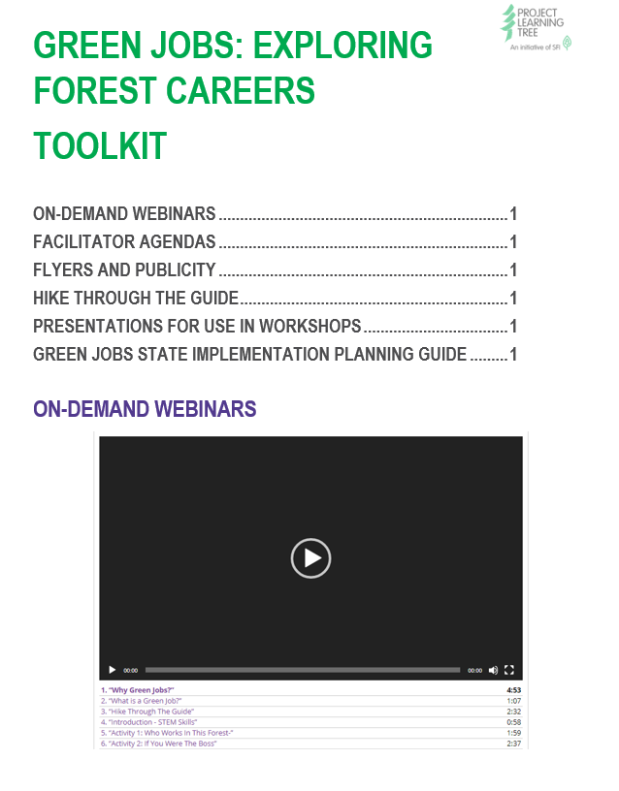





GREEN JOBS: EXPLORING FOREST CAREERS
EDUCATOR GUIDE AND RESOURCES RELEASED OCTOBER 2019
Special thanks to our funders
Notes:
GJ Educator Guide released in October
Implementation toolkit for the network
NGSS correlations
webinar on how to promote and deliver GJ PD
Special thanks to USFS and SAF for funding print and online resources
Inspired by work in Canada

Slide 13


BRAND REFRESH
Redesigned K-8 Guide
Solutions-focused Messaging
Website Redesign
    New navigation
    Revised content
Logo Changes
Notes:
Current brand look and feel about 15 years old, time to refresh and opportunity to show more clearly that we are part of the SFI family
K-8 guide, activity layout will remain very familiar, but guide will have new fresh look
Phased implementation on logo adoption by states, support those of you who want to adopt sooner

Slide 14
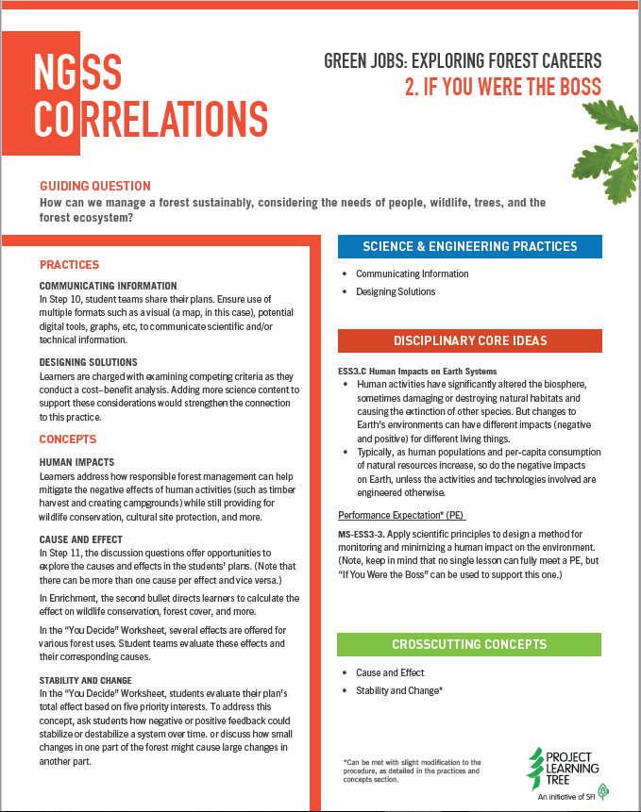
STANDARDS ALIGNMENT
APPROACH OF PLT ACTIVITIES
Adoption of three dimensions of learning
  Disciplinary Core Ideas
  Science and Engineering Practices
  Crosscutting Concepts
Alignment with Common Core
CURRICULUM – SCDE Standards
New K-8 Guide
New Early Childhood Guide
Focus on Forests Secondary Guide
Other Modules?
Notes:
PLT’s curriculum is developed with the three dimensions of learning
emphasis on inquiry
what students need to know about science,
also what they are to be able to do.
Apply framework of practices and concepts to NGSS and Common Core
Just released an NGSS Toolkit for Green Jobs: Exploring Forest Careers
one-page NGSS correlations sheet for each activity
Description of how this essential content is organized.
Designed to be relevant to states that have not yet adopted NGSS, or have their own state-specific science standard variations.
The Revised K-8 Guide will take a similar approach to NGSS correlations
Stay tuned for upcoming webinar on Three-Dimensional Science Standards to learn more
Thanks to KAEE for their leadership and collaboration in this work

Slide 15
TIMELINE FOR 2020 and beyond
JUN - SEP
“Find Your Green Job”
Online Quiz
Early Childhood Pocket Guide
Green Jobs Online PD
Next Gen: Facilitator Handbook,
including Preservice
Virtual Blended PD Event Toolkit
Thematic Bundles online
OCT - DEC
Nature Activities for Families
Forestry Literacy Framework
PLT Facilitator Training
Quick Guide for Forestry Professionals
Thematic Bundles online
2021
K-8 Guide
K-8 Online Course
Website with Searchable Index and National Workshop Map
User Registration & Dashboard
PLT Facilitator Training
Thematic Bundles online

Slide 16
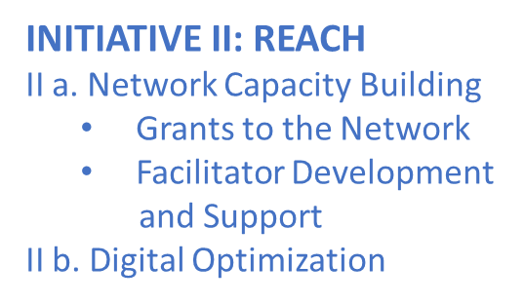

2020 GRANTS TO THE PLT NETWORK
EDUCATION, COMMUNITY & ee360 GRANTS
52 INDIVIDUAL GRANTS
32 STATES
$360,000
GRANTED
Notes:
Network does amazing work
Now three ways that we support: Education (formerly MPI), Community & ee360 grants
52 individual grants
32 states received one or more grants
Over $360K awarded

Slide 17
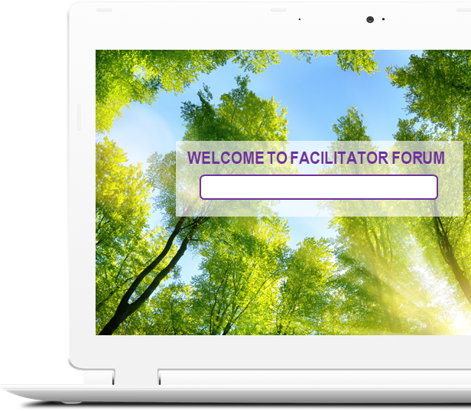
FACILITATOR DEVELOMENT & SUPPORT
KEY ELEMENTS
Online and on-demand training in standard topics
New and upgraded resources
Facilitator Handbook
Promising Practices in Preservice
Agendas and guidance for in-person training
More teachers as facilitators
Stronger community with national online platform
Notes:
Facilitators also at heart of PLT Community, face of PLT
challenges are recruiting facilitators, training them and keeping them engaged.
National PLT disseminating information and best practices to both Coordinators and facilitators
formal educators as facilitators, ambassadors and peer trainers to help us work more closely with school districts to meet state and district mandates
Hope to Accomplish?
Create a more consistent PLT professional development experience for all participants
Alleviate repetition across states and free up state resources to focus on your state’s unique requirements
Expand number of active and well-trained facilitators ready and willing to offer PD
Engage more formal educators as facilitators and ambassadors for getting PLT into school districts.

Slide 18
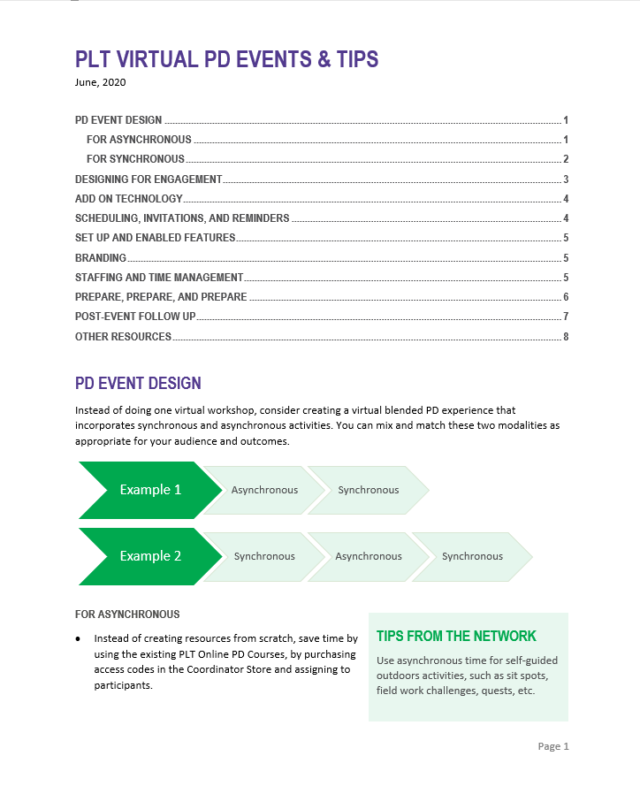
What SCPLT is working towards:
PLT FACILITATOR NETWORK
Virtual, Blended, In-person PD Event Toolkits ON “Facilitators’ Corner”
  Workshop Presentations
  PD Agenda Templates
  PD Events Best Practices & Tips
Virtual leadership development throughout the year
Notes:
listened to the network regarding the need for support to pivot your workshops online
producing a Virtual Blended PD Event Toolkit
PLT activities adapted to the virtual environment
PD agenda templates
Document with best practices and tips for conducting virtual PD events already available for download on Coordinators’ Corner.
We’ve also needed to pivot in how we provide PD to you, what we call our Virtual Leadership Development
We’ve conducted four webinars & virtual chats
planning more virtual experiences throughout the year
webinar on Virtual PD, Three-Dimensional Standards, such as the Next Generation Science Standards
chat on CoP with Joe and Libby on Qs

Slide 19


MARKETING & PROMOTION
Create original content weekly
Distribute via The Branch newsletter monthly
Promote and source other content for
social media daily
Other tactics include:
  Free advertising on Google
  Pop-ups and landing pages
  Free teaser resources for
  drip email marketing campaigns
Notes:
3-4 new articles every month featuring a variety of tools, tips and resources for using PLT
50,000 subscribers to The Branch, add approx. 1,500 new every month
12,000 followers on Facebook and 2,500 on Twitter, and 52,000 monthly viewers on Pinterest
PLT’s website is now getting 888,000 visitors a year, and 2 million pageviews (that’s nearly 3x the traffic compared to previous year)
We are utilizing $10,000/month every month in free advertising through the Google AdWords grant for non-profits

Slide 20
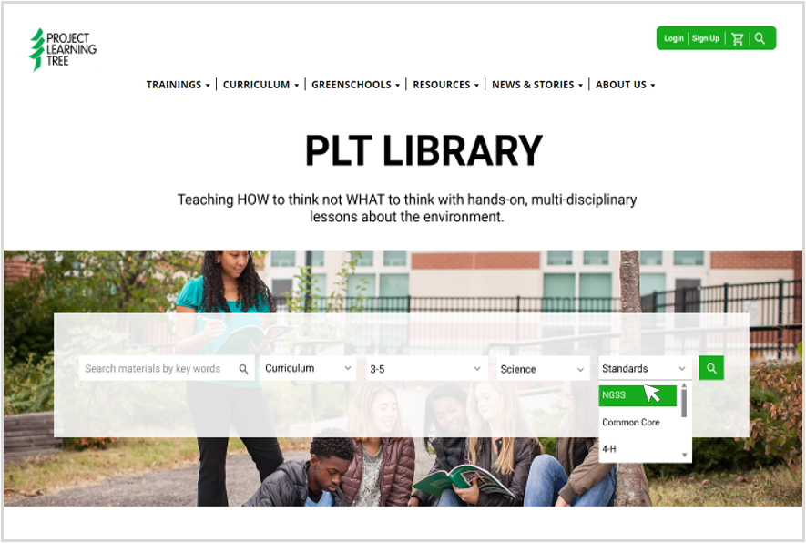
DIGITAL OPTIMIZATION
Searchable Index for Users to find PLT activities suited to their needs
New User Registration and Account Dashboard
National Workshop Map or calendar to promote your great in-person professional development events
Notes:
Searchable index: Grade level, academic standard, setting, topic
User Reg and Dashboard: to make it easier for people to register, improvements to PIF, merging user dashboards (shop.plt.org for purchase content) and plt.org firewall login (free resources); want to make this a single account dashboard for all of a user’s content
National Workshop Map to make it easy for people to find and register for state in-person workshops; think about it from a users perspective, simplify; stay tuned as we want this to design this to make as easy as possible for you too

Slide 21

INITIATIVE III:
REVENUE
REVENUE & DEVELOPMENT
DEVELOPMENT AND CHARITABLE GIVING
  11 proposals submitted Feb 1- Jun1
  $1.8 - $2.4 million requested
PROGRAM REVENUE
  2020 Sales to Coordinators: $112,224
    Print guide sales down
    Online, e-unit, e-books up
  2020 Sales to Educators: $30,120
    Just surpassed 2019 sales!
Notes:
Covid impacting the work of public agencies and nonprofits across the board.
Need to address human suffering and economic impacts is great.
Important role that we play
Resources for educators teaching remotely, classroom teachers as well as nonformal educators running virtual summer camps
Resources for homeschooling parents and guardians
Getting kids outdoors where it’s safe, providing fun hands-on activities that meet educational objectives
Connecting them to the natural world, a place of renewal and stress-relief in difficult times
Virtual resources are critical right now
Online courses
E-units
E-books
Nature activities for families
Also now developing webinar and resources to support state virtual blended PD events
Excited to have Sheden Alsaaty on staff to head up our development activities
With Sheden’s leadership and active support across the staff, we are actively seeking new funding opportunities to support the initiatives in our business plan.

